Slide 1

User-Centered Website Development: A Human-Computer Interaction Approach

Slide 2
Daniel D. McCracken
City College of New York
Rosalee J. Wolfe
DePaul University
With a foreword by:
Jared M. Spool, Founding Principal,
User Interface Engineering
PowerPoint slides by Dan McCracken, with thanks to Rosalee Wolfe, S. Jane Fritz of St. Joseph’s College, and Rhonda Schauer

Slide 3

Credits
Slides 7 and 35-44: Daniel D. McCracken.
Slide 29: Courtesy of American Honda Motor Co., Inc.
Slide 31: Courtesy of Crate&Barrel.
Slide 33: Courtesy of Mattel, Inc.
Slide 45: Estate of Horace W. McCracken.

Slide 4
9. Color
In this chapter you will learn about:
Physical and perceptual aspects of color
Several color models and the advantages of each
Four color-harmony schemes
Some examples of color in nature, relating them to our vocabulary of color
Tool programs available to you for studying color
How color can make Web pages pleasing and easy to read

Slide 5
9.2 The Physics of Color
The spectrum of visible light
The electromagnetic spectrum
Human response to color

Slide 6
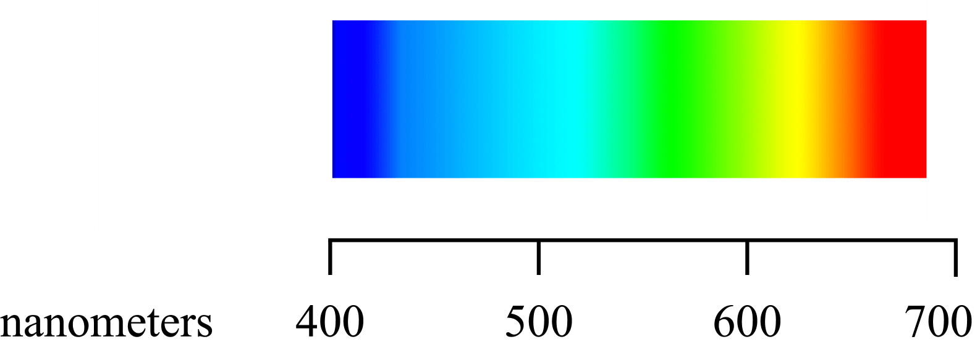
The spectrum of visible light

Slide 7
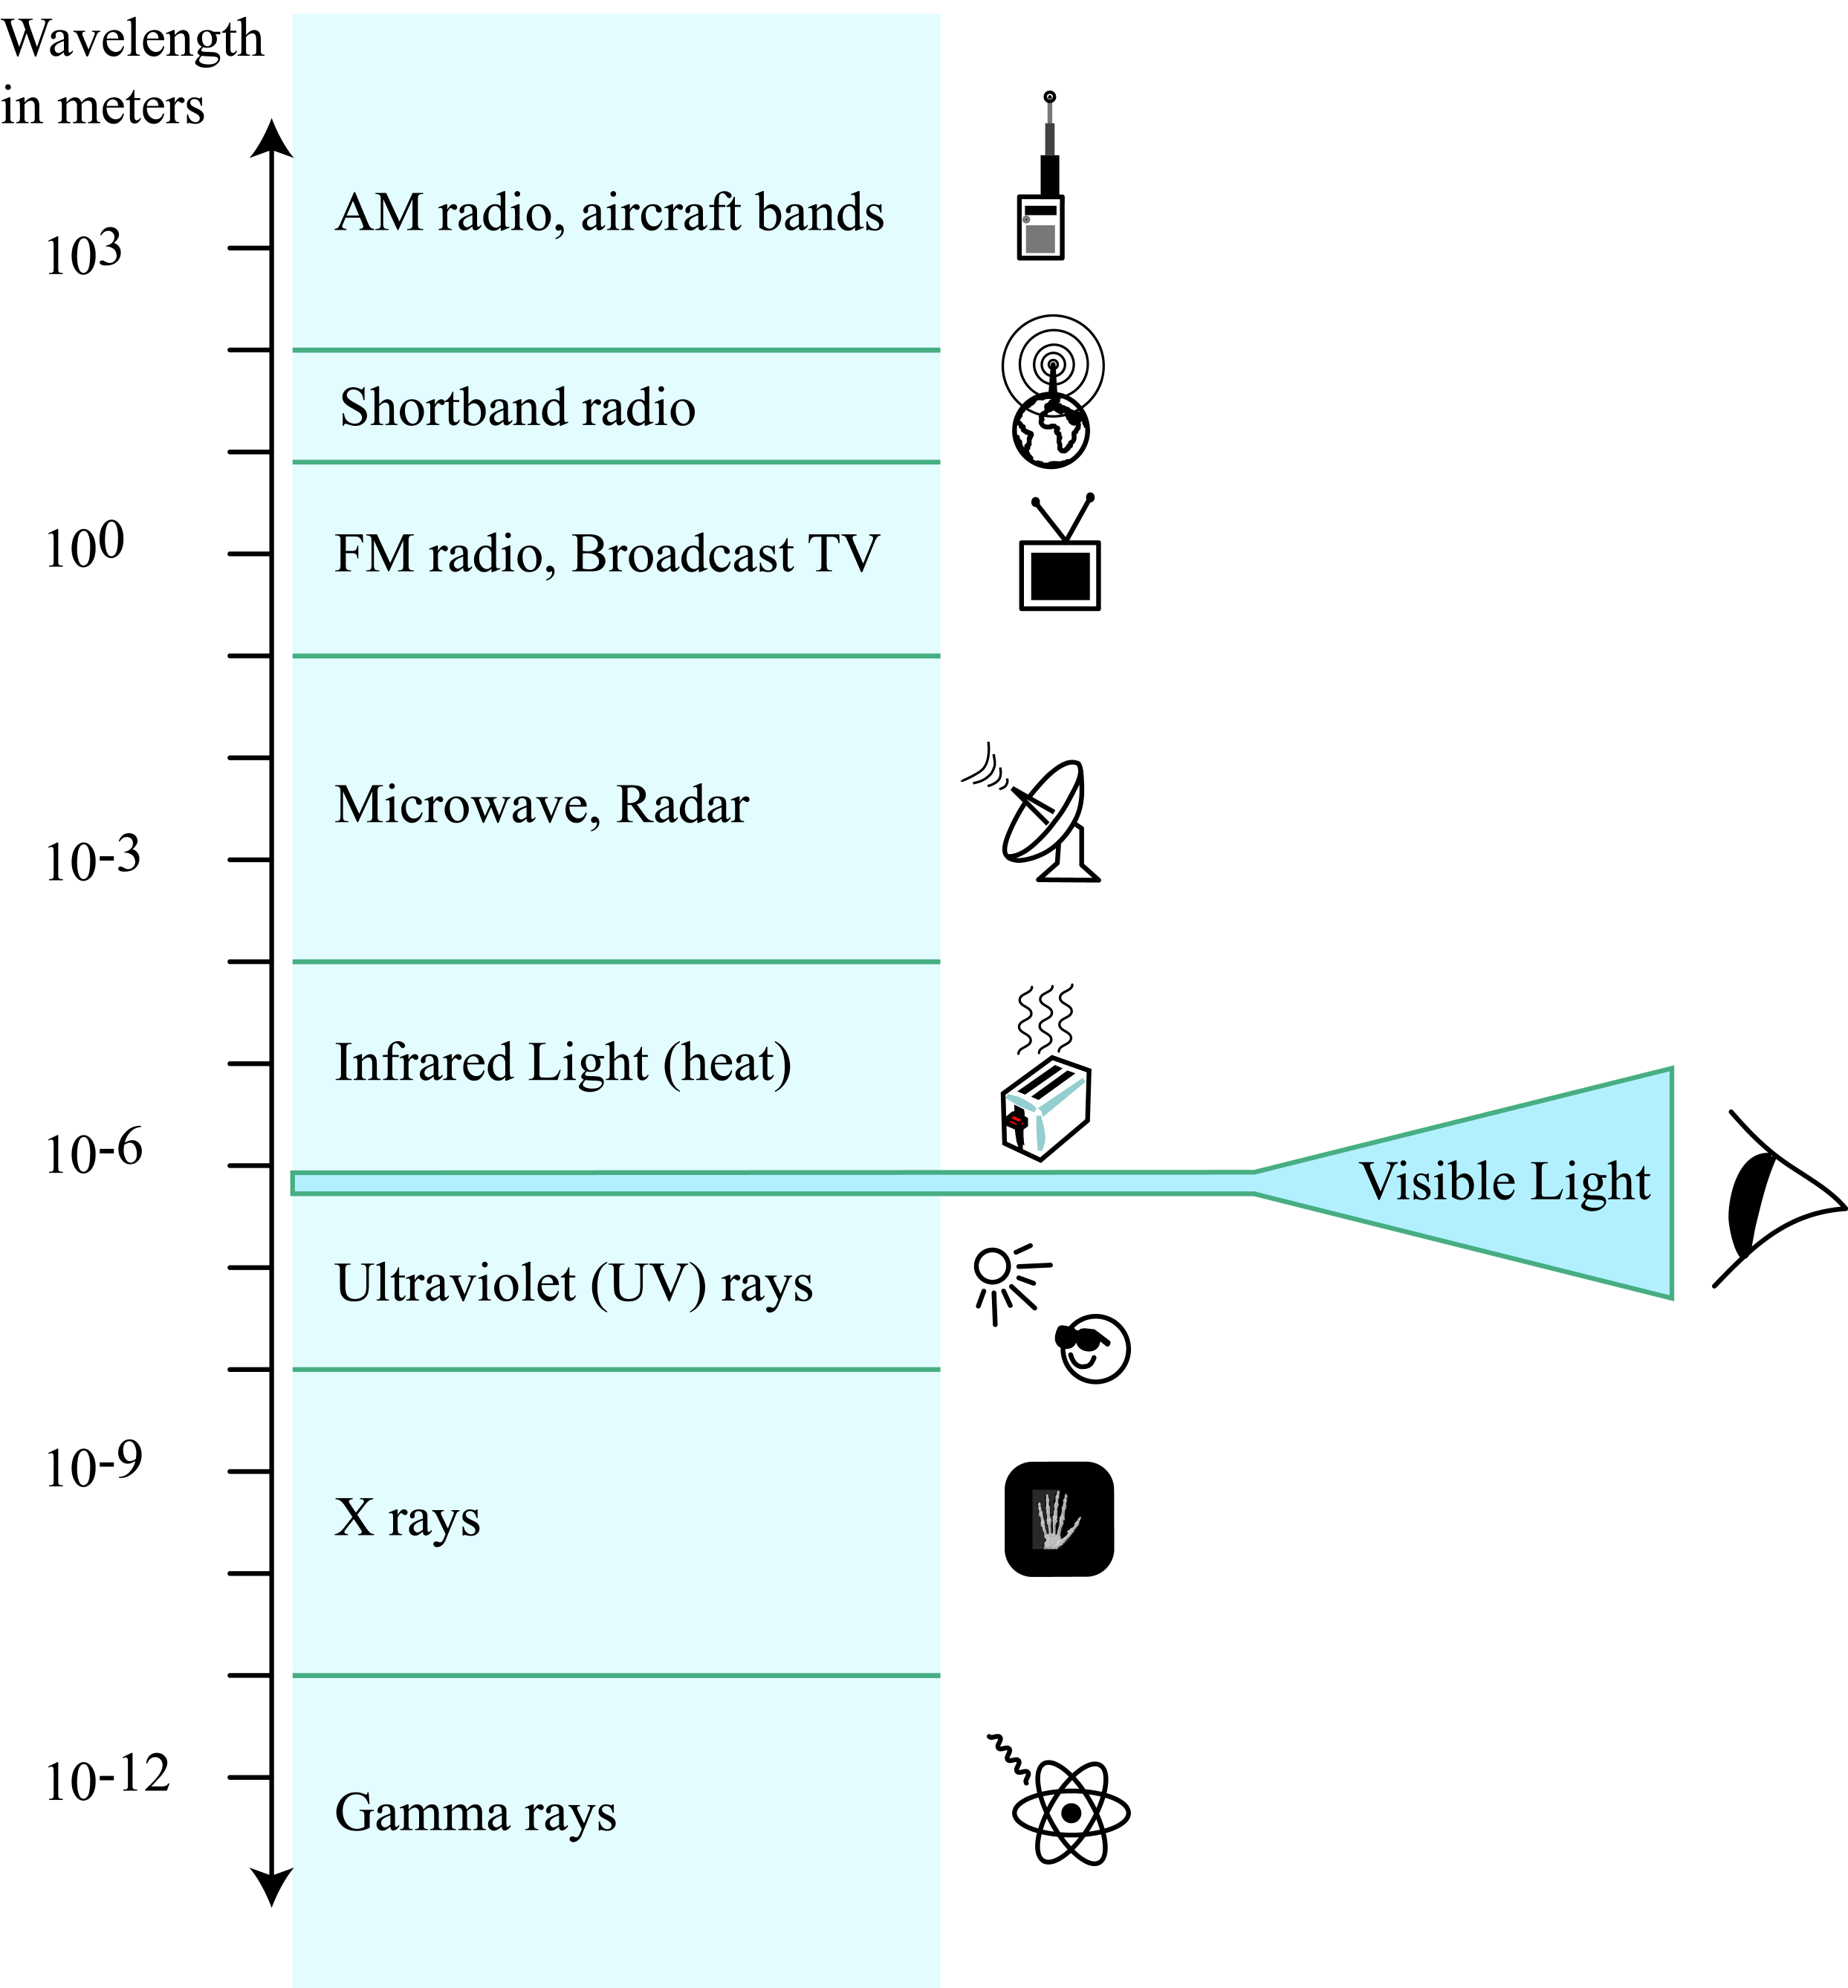
The electromagnetic spectrum, of which visible light is a very thin band

Slide 8
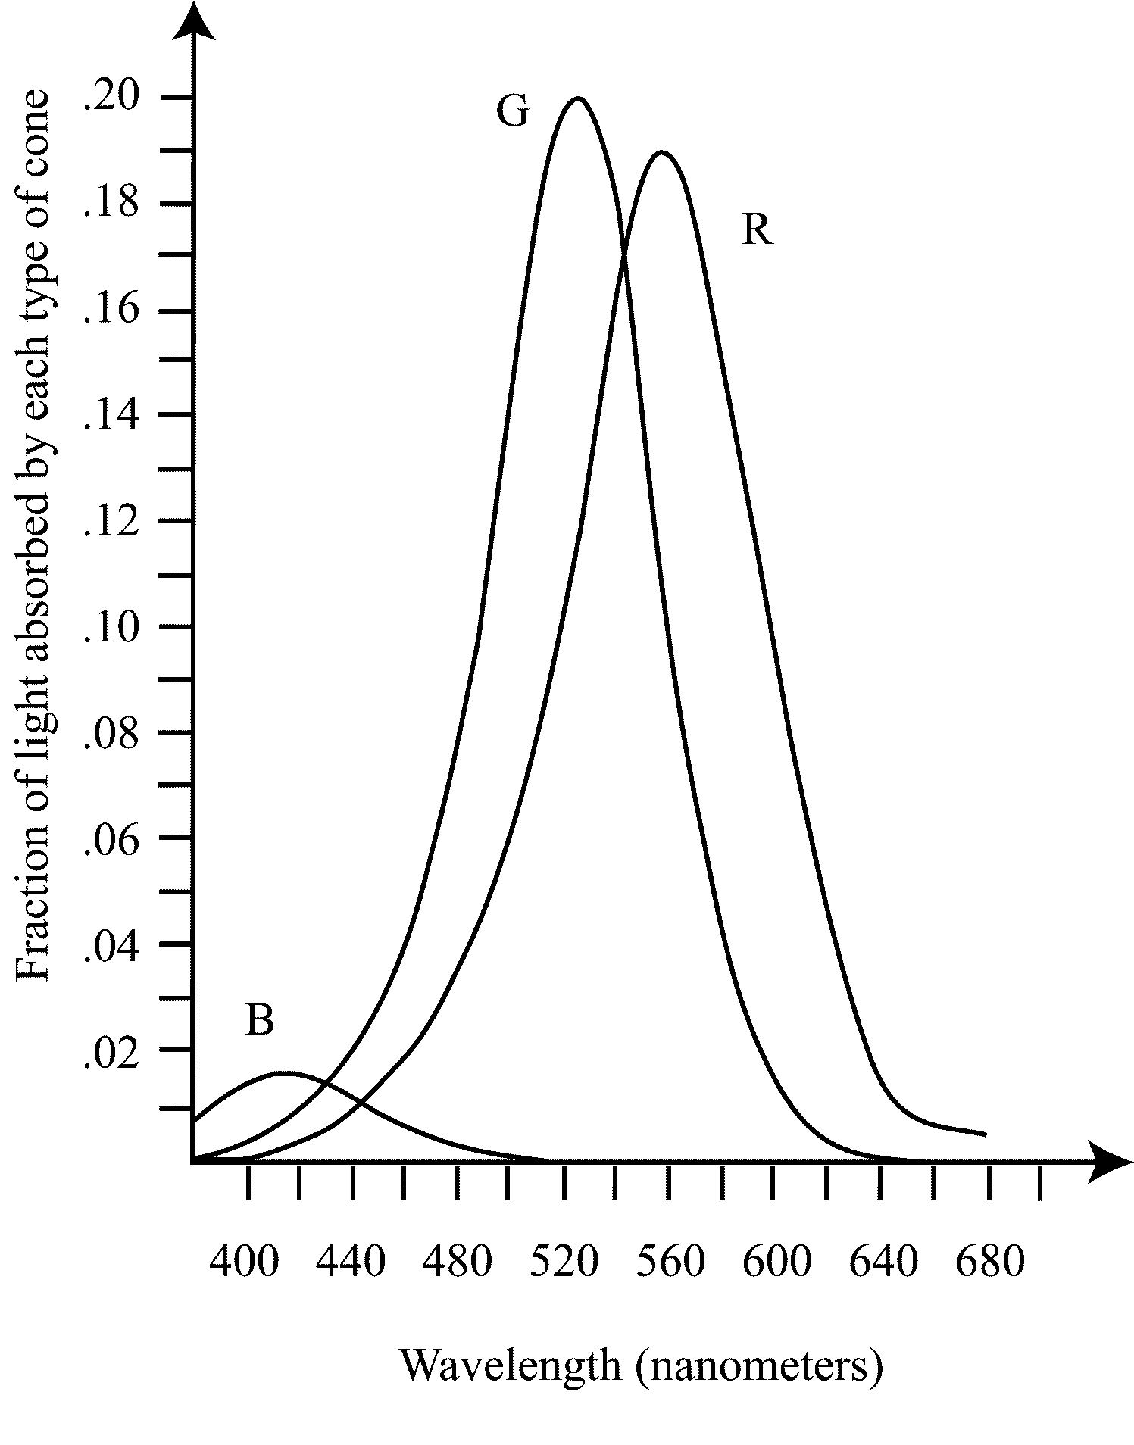
Human response to color

Slide 9
9.3 Color Models
A color model is a representation system for describing a color more precisely than would be possible with nouns and adjectives
An artist’s color wheel: red, yellow, and blue (RYB)
Additive color: red, green, blue (RGB)
Subtractive color: cyan, magenta, yellow, and black (CMYK)
Hue, saturation, and brightness (HSB)
L*a*b

Slide 10
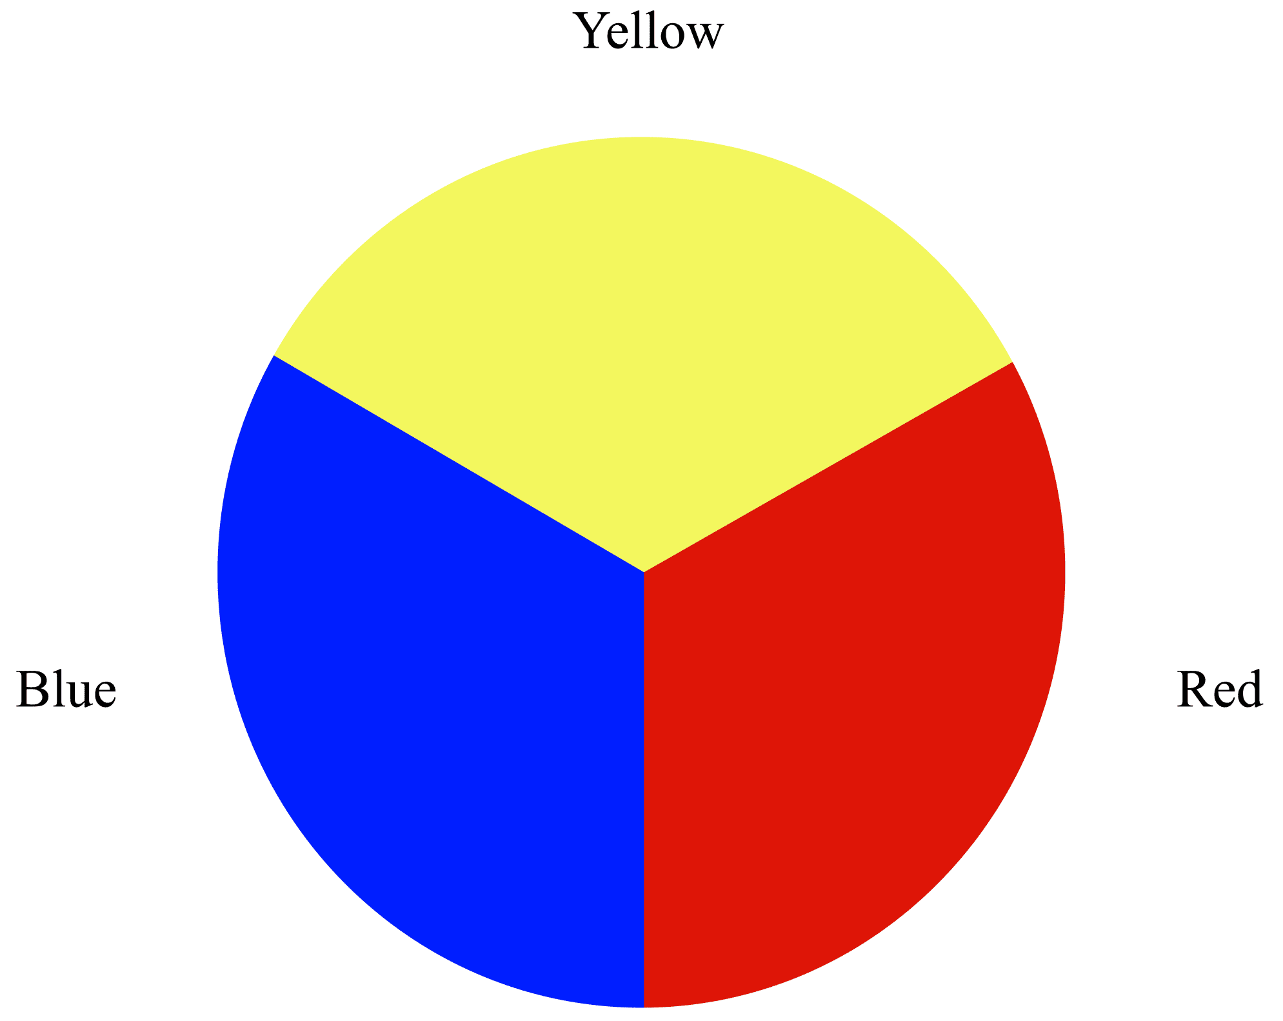
The artist’s model: red, yellow, and blue

Slide 11
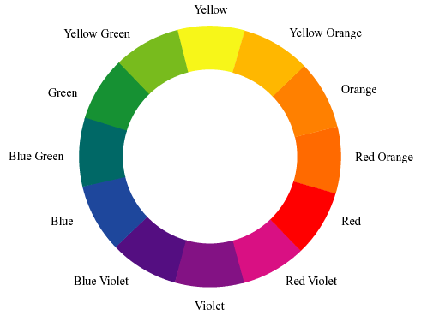
An artist’s color wheel

Slide 12
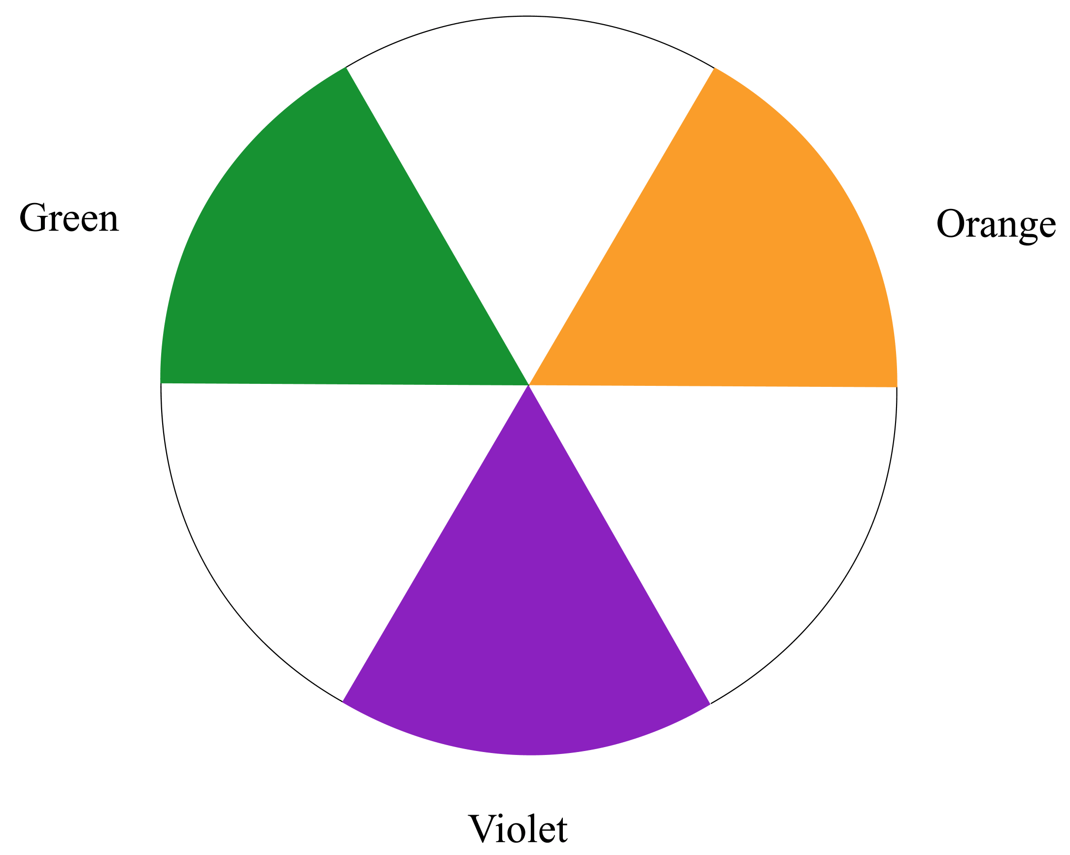
The secondary colors

Slide 13
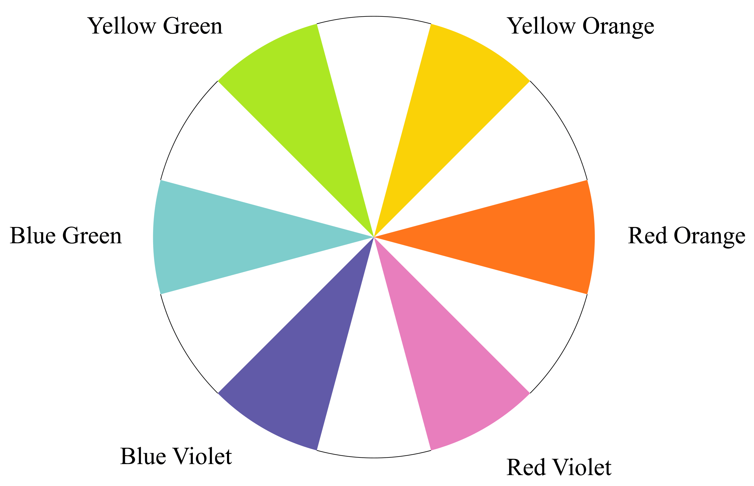
The tertiary colors

Slide 14
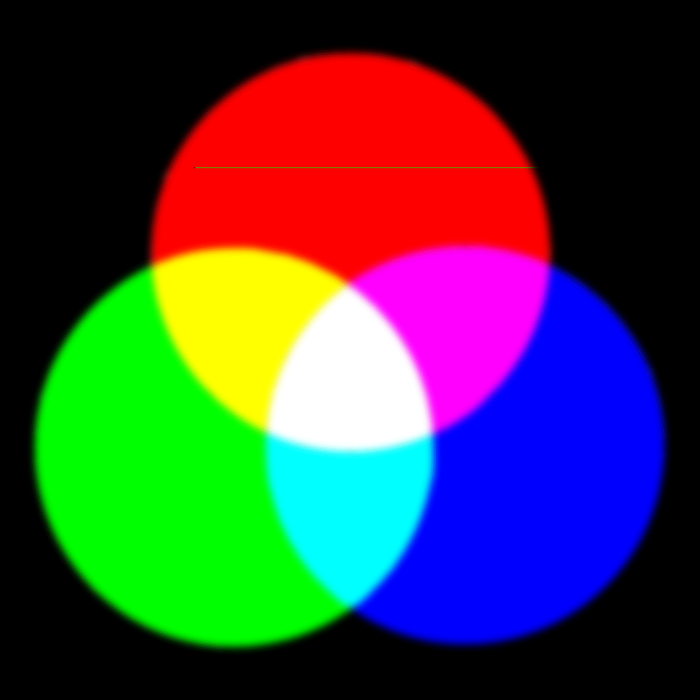
Additive color: things that emit light, especially monitors (RGB)

Slide 15
In additive color . . .
Red + Green = Yellow
Red + Blue = Magenta
Green + Blue = Cyan
Red + Green = Yellow? Yes, when you add colors. Paint and print subtract colors.

Slide 16
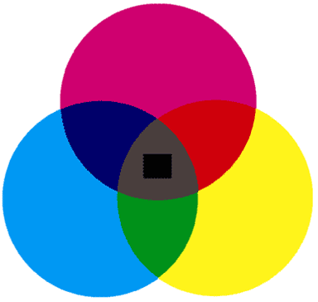
Subtractive color: things that reflect (and selectively absorb) light (CMYK)

Slide 17
In subtractive color . . .
Cyan subtracts red
Magenta subtracts green
Yellow subtracts blue
In photography, that’s it: all three together subtract all light, giving black
In print, the dyes aren’t that good, and we need black ink too
Hence, four-color printing: CMYK
K from blacK; B already means Blue

Slide 18
HSB: Hue, Saturation, and Brightness
Hue: where a color lies around a color wheel: red, green, yellow, blue-green, etc.
Saturation: the “purity” of a color; a fully-saturated color has no white mixed with it, in paint terms
Brightness: light, dark, or in between?
In everyday use, most people probably are thinking of hue when they speak of color

Slide 19
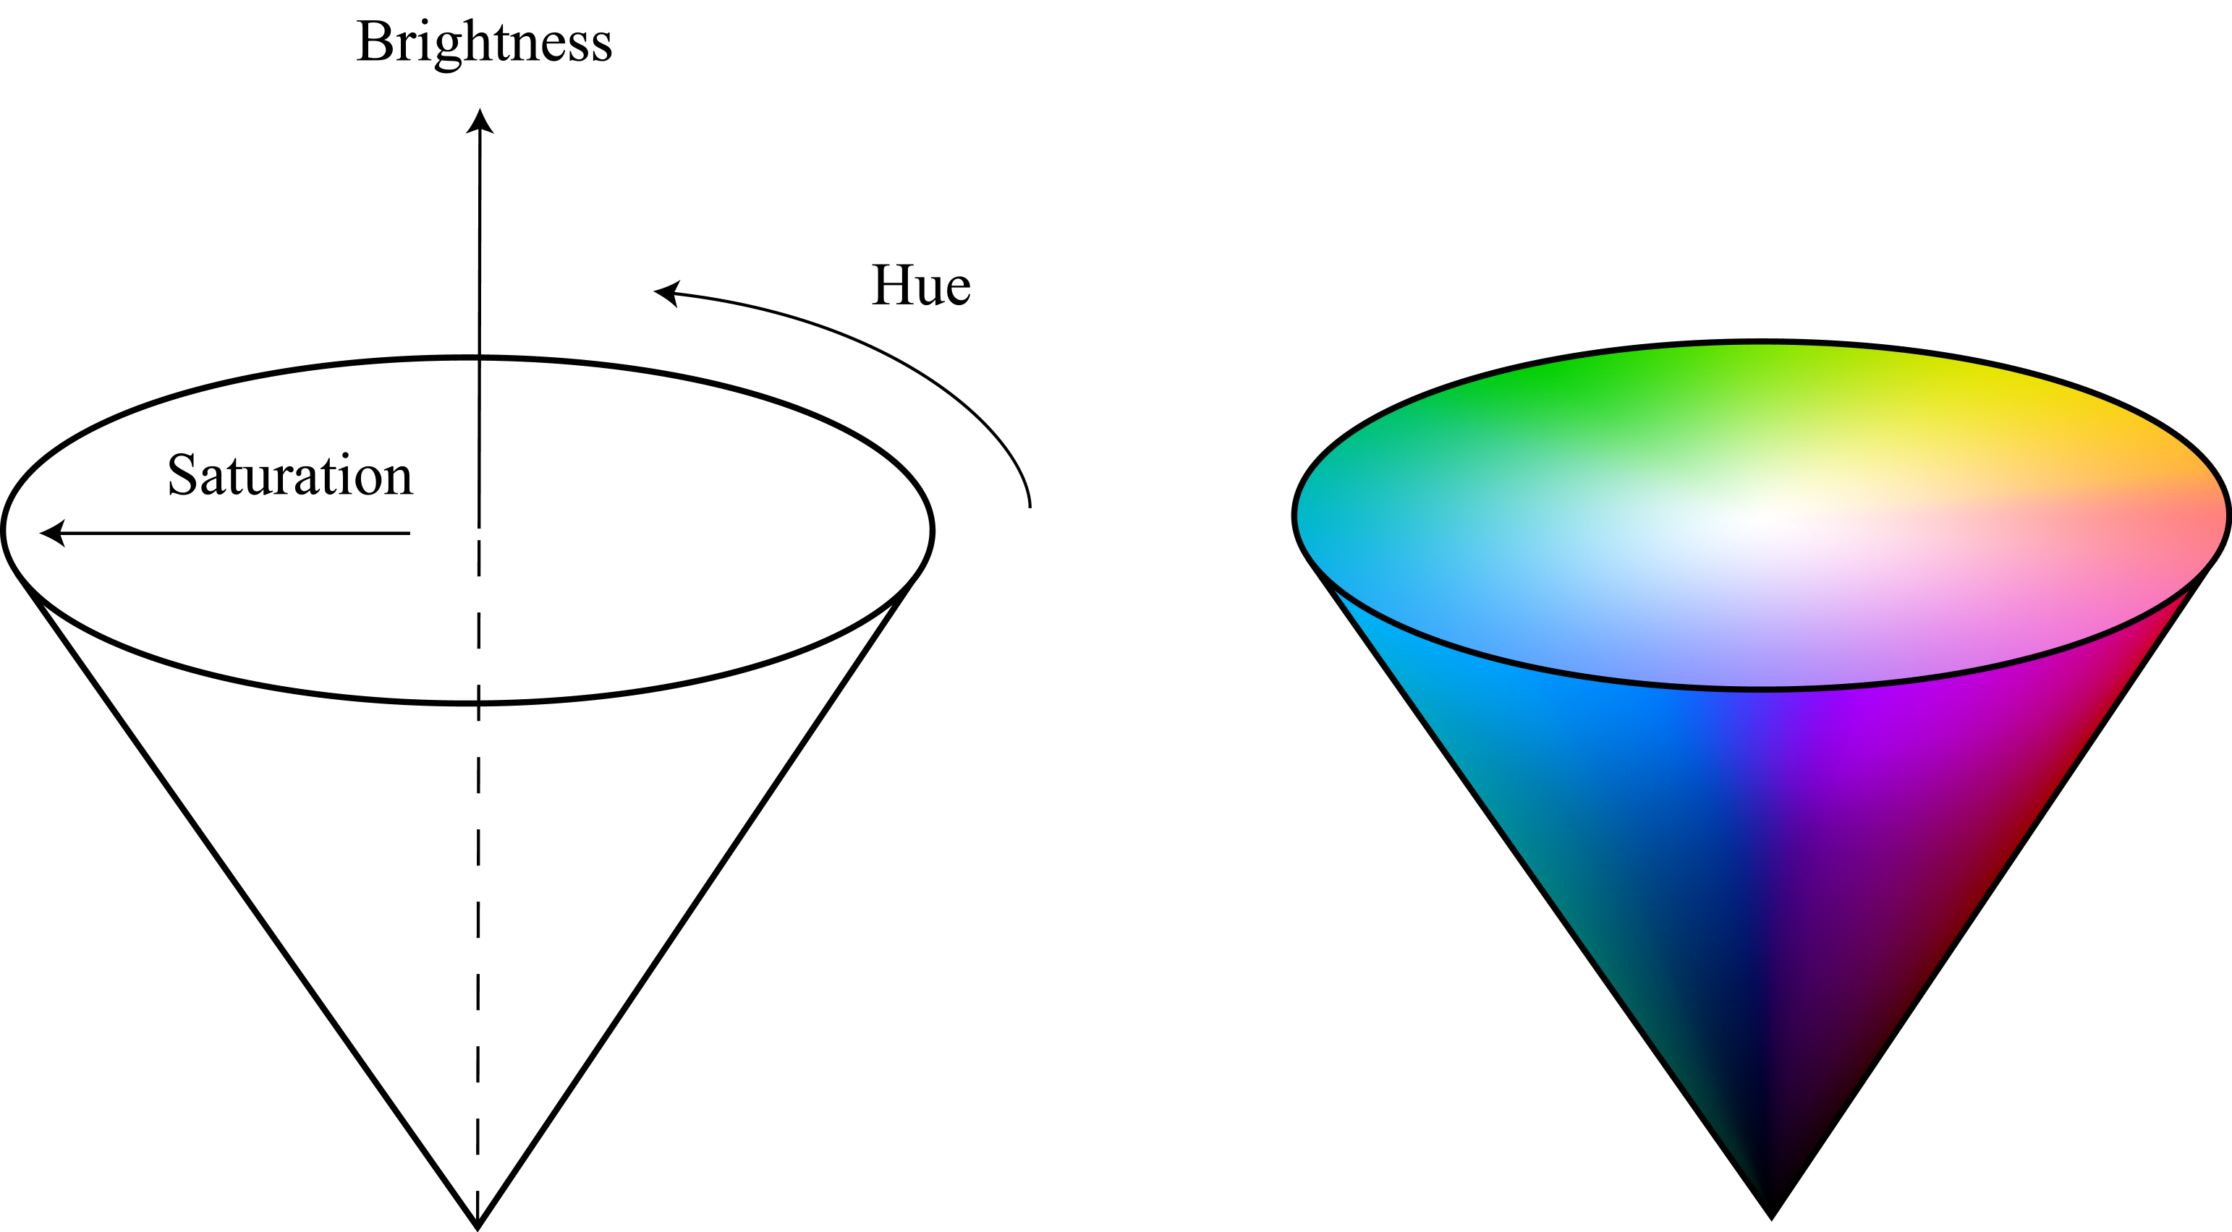
The color cone: hue, saturation, and brightness in relation to each other

Slide 20

White, black, and all grays are zero percent saturated
A color becomes more saturated as it moves away from gray to a pure color
A pure (fully-saturated) color, in RGB terms, in one that contains:
  Only red, green, or blue, or
  Only yellow (= red + green), or
  Only magenta (= red + blue)
  Only cyan (= blue + green)

Slide 21
More on saturation, continued
Note: the previous slide said nothing about the brightness of those pure colors
A saturated color can be a brilliant yellow, but
It can be a deep crimson, or midnight blue
The flower pictures, Slides 35 to 44, show many combinations of brightness and saturation

Slide 22
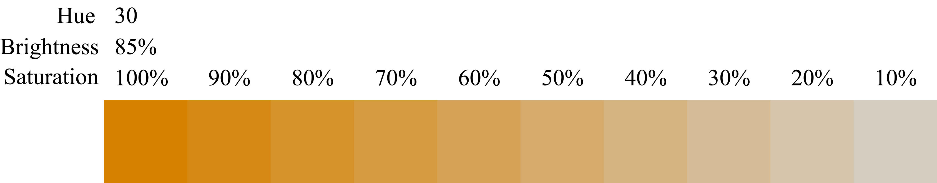
Varying saturation, with brightness held constant

Slide 23
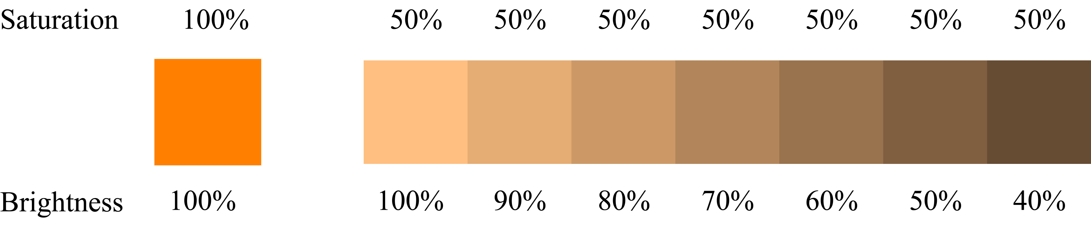
Varying brightness, with saturation held constant

Slide 24


L*a*b
L is luminance
a specifies where a color lies on an axis that runs from green to red
b specifies where a color lies on an axis that runs from blue to yellow.
The L*a*b model is the internal representation of color in Adobe products and in Postscript.
L*a*b is also the basis of ordinary TV (not digital).
The format was adopted at a time when there were very few color television sets
  the color signal needed to be compatible with black and white sets
  Black and white sets look only at the luminance portion of the signal and ignore the chrominance portion.

Slide 25
9.4 Four Color-Harmony Schemes
Monochromatic: colors of same or similar hue, differing in brightness and/or saturation
Complementary: colors approximately opposite each other on a color wheel
Analogous: colors adjacent to each other, from any segment of a color wheel
Triadic: three colors approximately equally spaced around a color wheel

Slide 26

Monochromatic color harmony: colors of same hue, differing in brightness and/or saturation
All blue
All orange

Slide 27
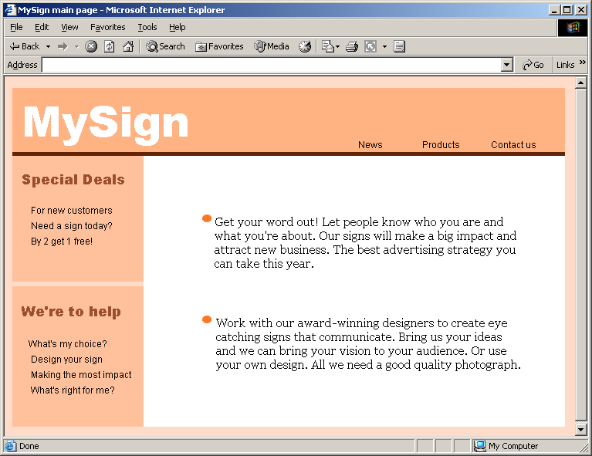
Monochromatic example: orange, with variation in brightness and saturation

Slide 28

Complementary: red and green

Slide 29
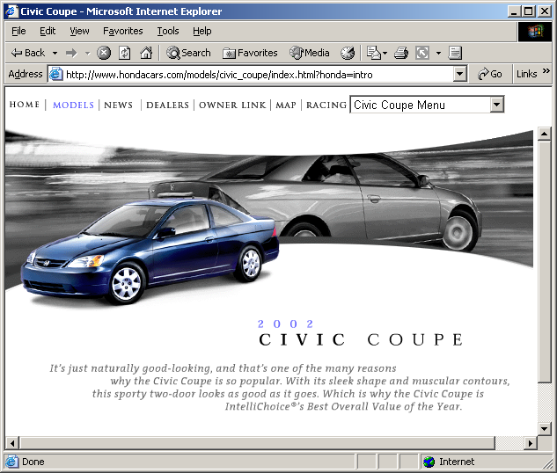
Complementary: various blues, with red-orange highlights

Slide 30

Analogous: bright orange, darker yellow-orange, light yellow

Slide 31
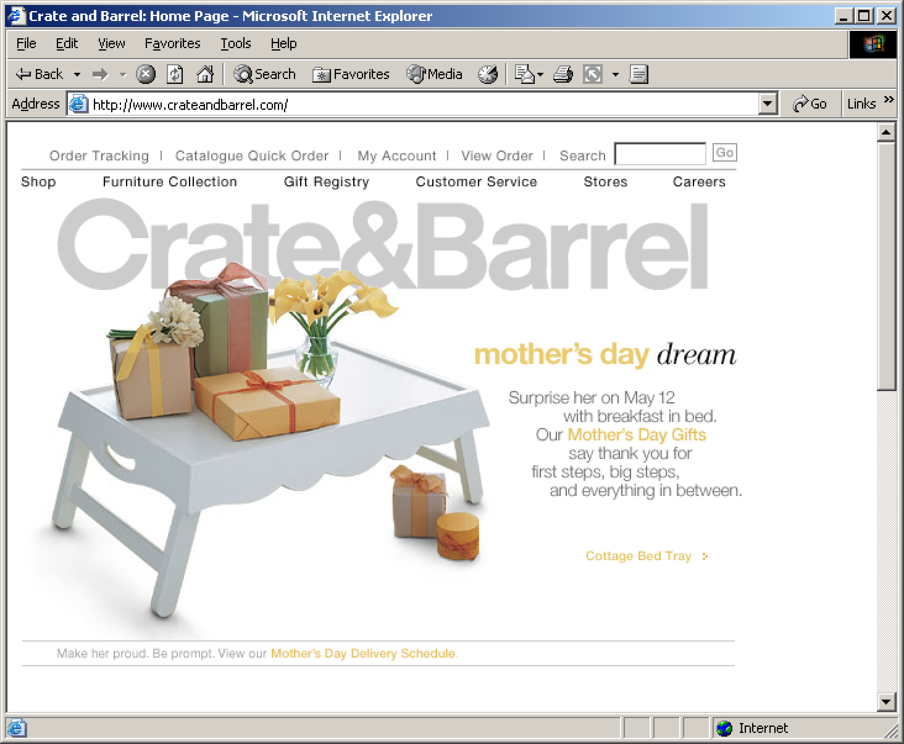
Analogous: red-orange through yellow-green

Slide 32

Triadic: red, yellow, blue

Slide 33
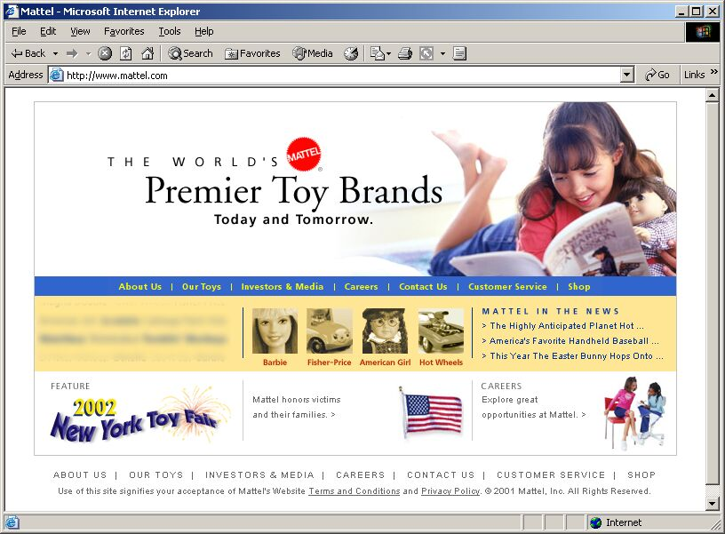
Triadic: red, yellow, blue

Slide 34
The color software at the companion Web site is a great way to learn
Permits simple experimentation with the concepts, e.g.:
  What is pink? (Desaturated red)
  Can a dark color be saturated? (Yes)
  Does adding red and green really give yellow? (Yes)
  Is gray ever saturated? (No)
  What does saturation mean at low brightness levels? (Not much)
  In RGB, how do you “add white” to red? (Increase the amounts of green and blue)
  http://www.prenhall.com/mccracken/

Slide 35
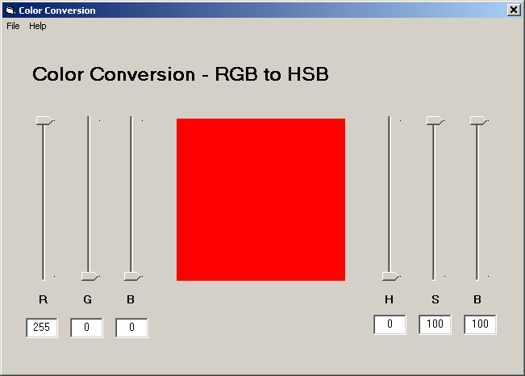
Here is pure red; what would we have to do to make pink?

Slide 36
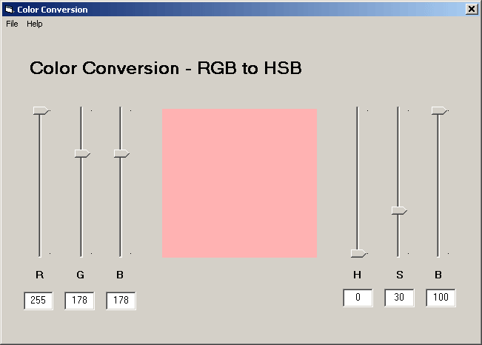
Answer: add green and blue

Slide 37
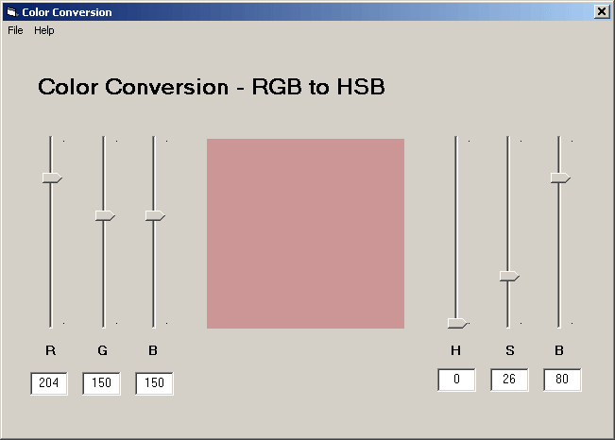
Lower all three, to get “dusty red,” maybe, although we don’t often use the language of fashion or interior decoration

Slide 38
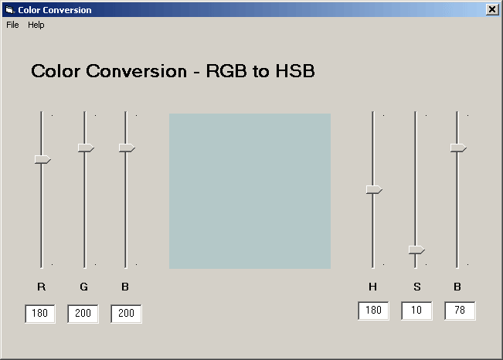
This is a cool gray: less red than green and blue

Slide 39
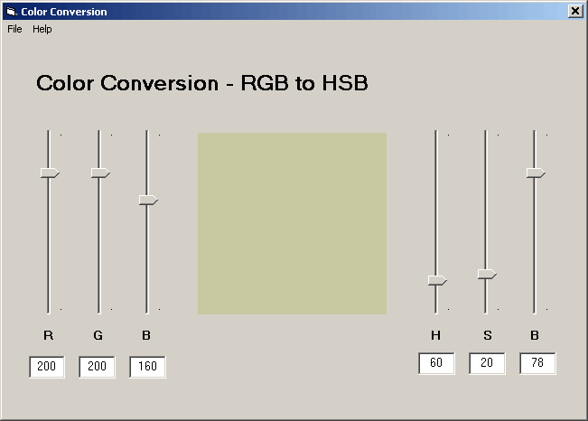
This is a warm gray: less blue than red and green

Slide 40
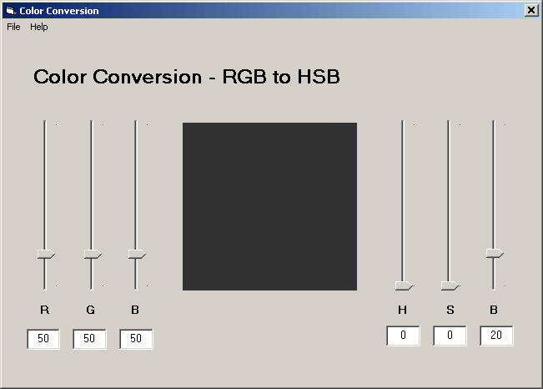
Is gray ever saturated? Let’s try: this is so dark as to be almost black, depending on room lighting; zero saturation

Slide 41
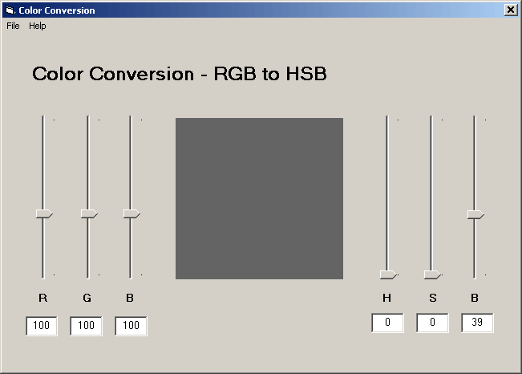
Another gray (same amount of R, G, and B); saturation still zero, brightness up

Slide 42
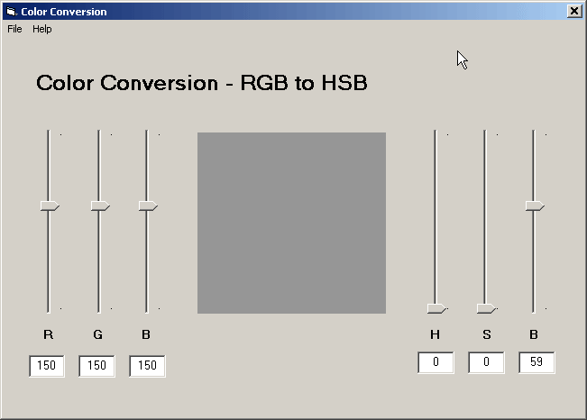
A lighter gray

Slide 43
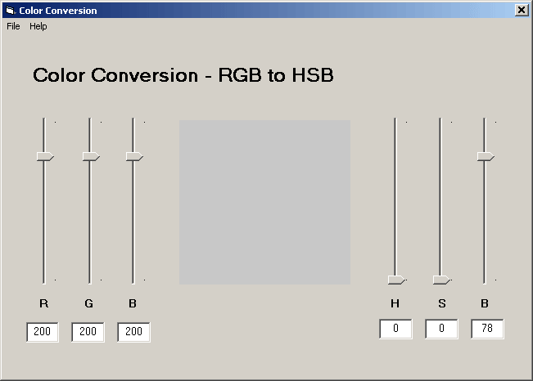
Gray getting toward white; still zero saturation

Slide 44

Black is completely unsaturated, right? Right.

Slide 45
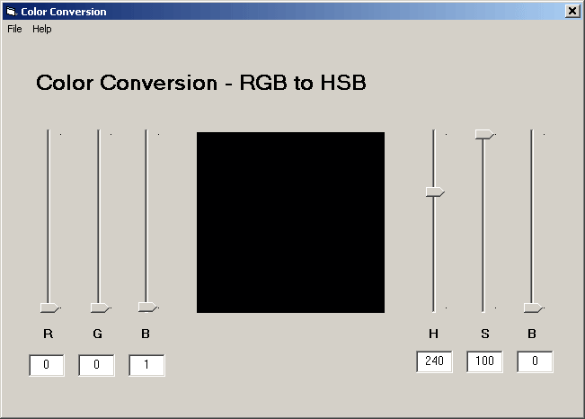
Change the amount of blue from zero to one: now 100% saturated (same result in Adobe and Microsoft software)

Slide 46
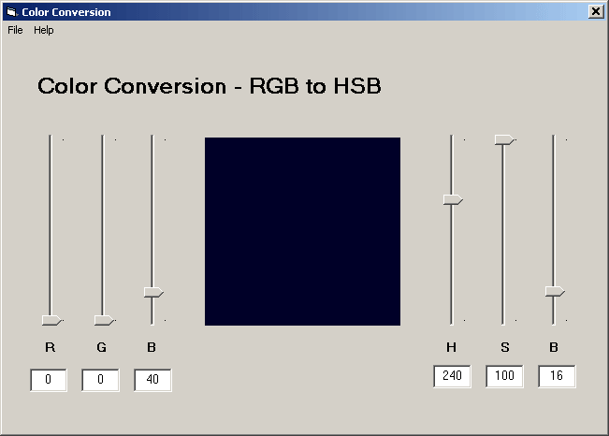
Now B = 40; can you distinguish from black? (Still 100% saturated)

Slide 47
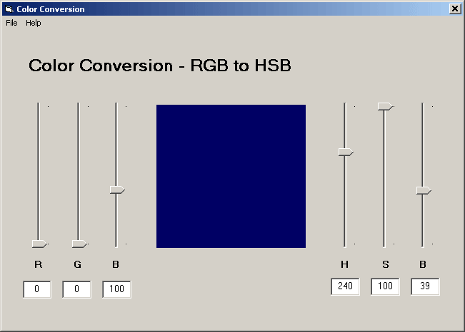
Now B = 100, and we have something like midnight blue; still 100% saturated—but now that begins to make sense

Slide 48
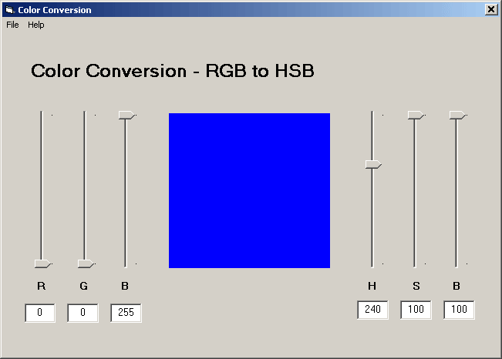
Pure blue; fully saturated by any definition

Slide 49
Moral
The axis of the color cone (Slide 20) runs from black at the bottom, through the grays, to white at the top
All points on the axis are unsaturated
Near the bottom of the color cone there is very little space between the axis and the pure colors
And the pure colors at the bottom of the cone are dark
Hence: saturation is not a helpful term for low-brightness colors

Slide 50
“I’d like the house painted a sky-blue yellow”
That was the description once given to a husband: “I want a yellow, but not a bright yellow; like sky blue isn’t exactly blue.”
The husband didn’t understand, but negotiation found the color
Now he understands: desaturate pure yellow, as in the following slides

Slide 51
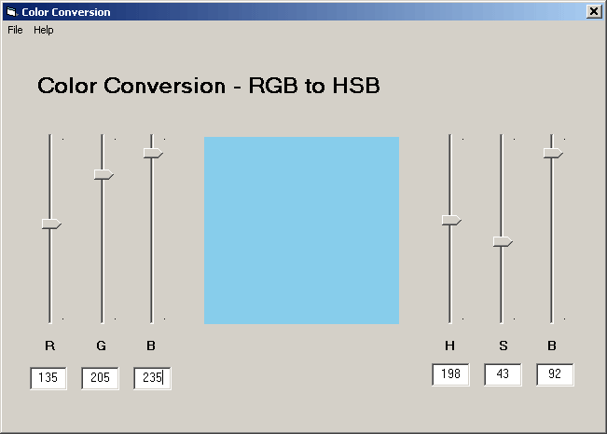
Starting point: what is sky blue? Find a sample somewhere; note its saturation and brightness

Slide 52
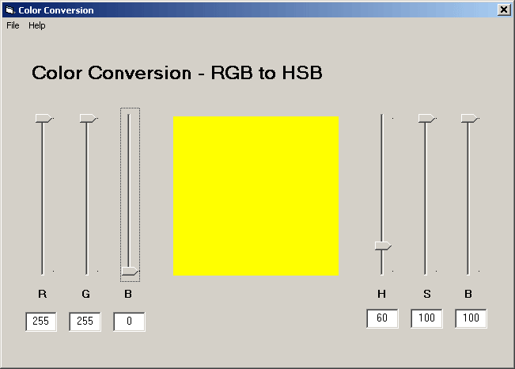
Now make a pure yellow, which is maximum red and green

Slide 53
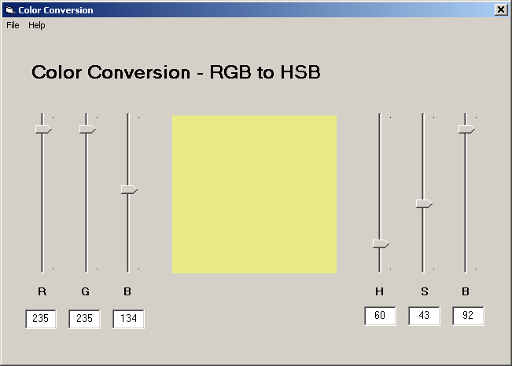
Now change the saturation and brightness to what we had for sky blue. Voilá! Sky-blue yellow.

Slide 54
The color matching tool from the companion website
Two versions: match using RGB or HSB model
Start with any of the hundreds of named colors available
That color appears in a top rectangle; bottom rectangle is black
Move sliders to match colors
Hints given; “warmer” means “your last change got you closer”
When you get a match, the number of adjustments taken is reported

Slide 55
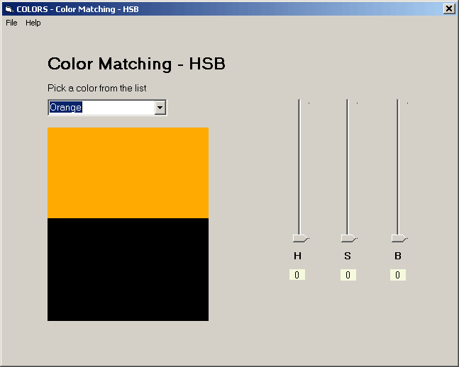
Let’s match orange, in the HSB model

Slide 56
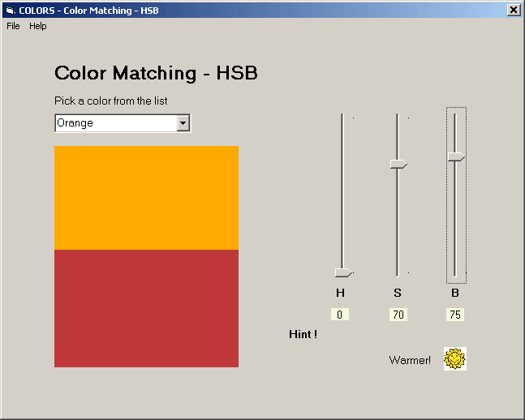
Increase saturation and brightness, so we can see where we are

Slide 57
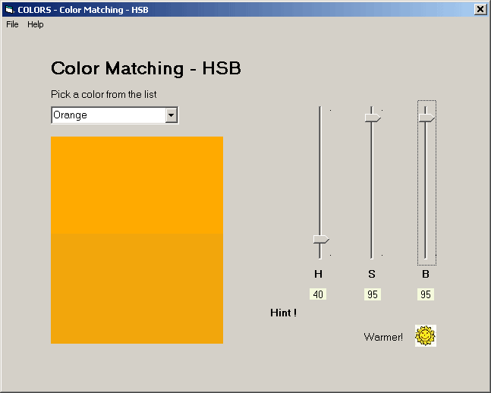
Need to increase saturation and brightness, and adjust hue

Slide 58
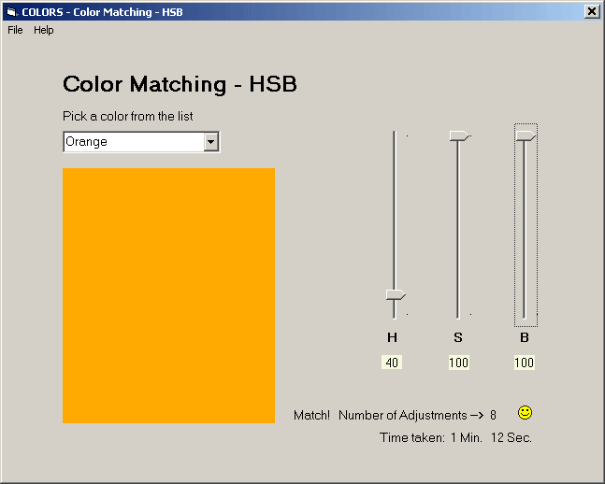
Success! (Not all adjustments were shown, obviously.)

Slide 59
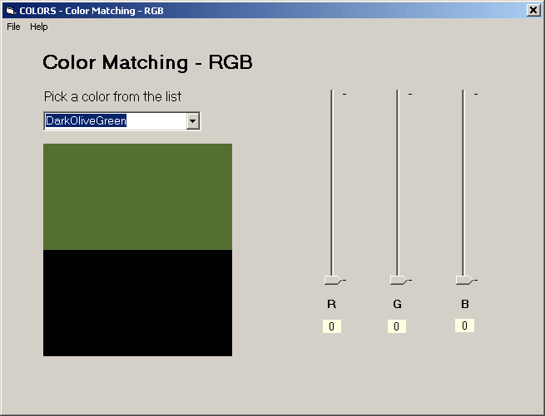
Let’s try a cool color, using the RGB model

Slide 60
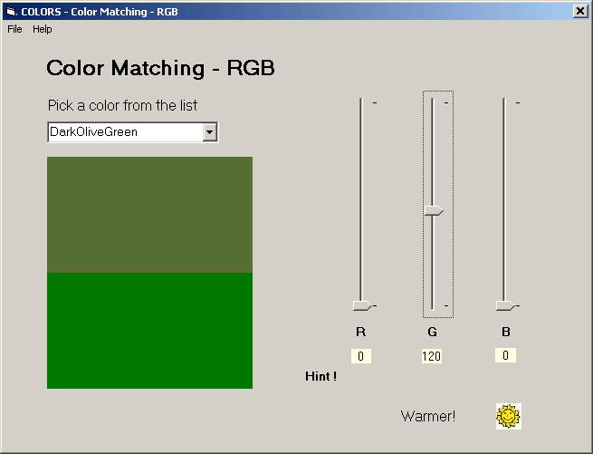
Dark olive green is green, but obviously not fully saturated

Slide 61
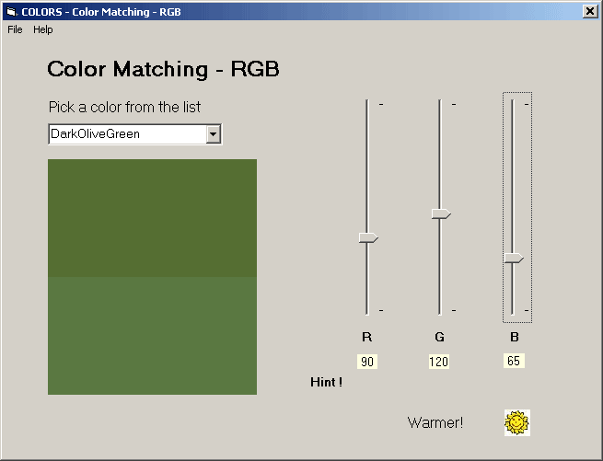
So add some red and blue to desaturate

Slide 62
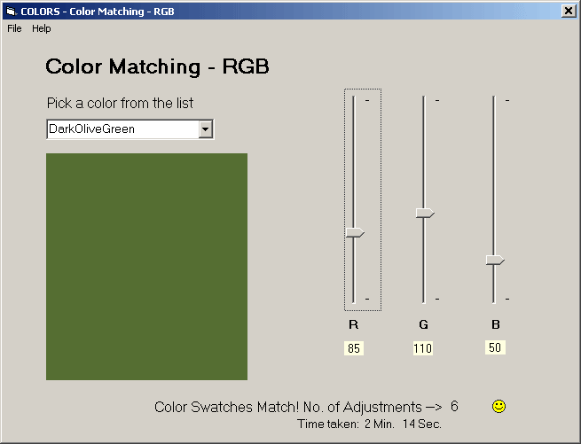
Success again—and again not all adjustments were shown

Slide 63
A little more on color harmony
In the text we were limited in the number of color pages we could use, so the examples of color harmony were necessarily restricted. With the luxury of more space here, we can add some additional material.
In printing color in the book there is also the problem of gamut: many colors we can produce on the screen cannot be printed on a CMYK printer. Examples: red, green, and blue.

Slide 64
The colors, laid out linearly instead of around a circle
On the next two slides we have the 12 colors of Slide 12, but shown in vertical bands
In each band the colors range from quite light to quite dark
Light colors may appear almost white—but that perception depends in part on background
Dark colors may appear almost black—same comment
So we show with a black background and then with a white background

Slide 65
























1
2
3
4
5
6
7
8
9
10
11
12
1
2
3
4
5
6
7
8
9
10
11
12
13
Chapter 9: Color
Copyright © 2004 by Prentice Hall

Slide 66
1
2
3
4
5
6
7
8
9
10
11
12
1
2
3
4
5
6
7
8
9
10
11
12
13

Slide 67
The four color-harmony schemes
Monochromatic: colors from one column
Complementary: any two colors whose column numbers differ by 6
Analogous: several colors from adjacent columns, with 12 considered next to 1
Triadic: colors from columns:
  1, 5, and 9, or
  2, 6, and 10, or
  3, 7, and 11, or
  4, 8, and 12

Slide 68



Three columns for picking monochromatic schemes; these three make a triadic
3
7
11

Slide 69
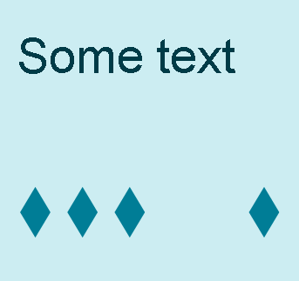
Monochromatic: Column 8, rows 2, 7, 12

Slide 70

Monochromatic: Column 1, rows 1, 4, 10

Slide 71
Three pairs of complementary colors (complements don’t have to scream)

Slide 72
But they can scream, if you wish (It’s called a clash—gets people’s attention)
But don’t do this casually—the clash can be almost painful; you need to have a reason to do it

Slide 73
A triadic can shout . . .

Slide 74
. . . or whisper . . .

Slide 75
. . . or speak conversationally . . .

Slide 76
. . . or let others talk . . .
Big Important Words
Nice words, but not headline-type words. Text. The story, now that I have your attention.

Slide 77
End interlude
End of Interlude
And that is what we have time for, in exploring another way of looking at color harmony. Try it! Think about the color combinations that work, and experiment with variations of them.

Slide 78
Further reading on color harmony
Anon. The New Munsell Student Color Set. Fairchild Publications, 1994.
Faber Birren. Principles of Color. Schiffer Publishing, 1987.
Cailin Boyle. Color Harmony for the Web. Rockport Publishers, 2001.
Hideaki Chijiiwa. Color Harmony: A Guide to Creative Color Combinations. Rockport Publishers, 1987
Bride Whelan and Lesa Sawahata. Color Harmony Workbook. Rockport Publishers, 2001.

Slide 79
Text and background colors for legibility
Rule #1: Provide adequate contrast
Rule #2: But not too much, and for extended use, black on white is too much contrast
Rule #3: Dark on light is better than light on dark, for text
Rule #4: There are no other rules
  Complements work
  So does a dark color on a background of the same hue but much lighter
  Light on dark is occasionally OK for headings

Slide 80
Text in a dark color on its complement in a light color works nicely
Color is one of the pleasurable aspects of eyesight and is an integral part of Web pages. Properly used, color makes a page both attractive and usable. It can provide cues that indicate a button’s function or state. It can distinguish between navigational aids and content, unobtrusively guiding the user through a page. This chapter presents some color basics and design tips to enhance both the effectiveness and appeal of a Web site.

Slide 81
A great many combinations are possible
In this chapter you will do the following:
understand physical and perceptual aspects of color
become aware of several color models and learn the advantages of each
learn to apply four different color harmony schemes
explore how color can make Web pages pleasing and easy to read

Slide 82
Even a little color in the background makes text easier to read
It is rare that the color choices for Web pages are left entirely in the hands of a developer or designer. In most cases, the client will already have some colors in mind, based on a corporate logo, a school insignia or personal preference. Color harmonies provide options for choosing colors that are compatible with the client’s wishes. Applying guidelines for text and background color will foster readability. Finally, using color to organize text and focus attention will result in easier navigation.

Slide 83
Now, for comparison, here is what black on white looks like
There is quite a bit of overlap in the response curves. The peak sensitivities for the first and second types are actually in the yellow range. There is a big disparity in the height of the three curves. This is due to the fact that human eyes are most sensitive in the green range of the spectrum and are dramatically less sensitive in the blue range.
Black on white may not look too bad here. But suppose you sat at a monitor six hours a day. Wouldn’t you prefer a pastel background? And text that is dark but not black?

Slide 84
But do provide adequate contrast
Offer expires 07/31/03. Offer available to new High Speed Internet subscribers only. May not be used in conjunction with any other offer. Service is not available in all areas. Certain taxes and fees may apply. DSL: Offer requires a 12 month subscription. First six months will be billed at $29.95 per month, 49.95 thereafter. Early termination fees apply. Includes Standard DSL Installation Kit. Does not include shipping and handling charges. Additional equipment may be required.

Slide 85
Always remember how we perceive blue vs. red and green
Below is the same text as on the previous slide, except pure blue instead of pure yellow. According to Adobe they both have 100% brightness, and according to Microsoft they both have luminance of 128. But that it not how we perceive them.
Offer expires 07/31/03. Offer available to new High Speed Internet subscribers only. May not be used in conjunction with any other offer. Service is not available in all areas. Certain taxes and fees may apply. DSL: Offer requires a 12 month subscription. First six months will be billed at $29.95 per month, 49.95 thereafter. Early termination fees apply. Includes Standard DSL Installation Kit. Does not include shipping and handling charges. Additional equipment may be required.

Slide 86
Don’t use red on blue or vice-versa
Blue has the shortest wavelength of visible light and red the longest. Blue is refracted more strongly than red in our lenses. (Compare with what a prism does to white light.) Result: our eyes can’t focus on red and blue at the same time, and the boundary seems to vibrate. It gets painful.
Camera lenses deal with this by using lens components with different indexes of refraction, to produce an achromatic lens, so that red and blue both focus at the focal plane. Our eyes don’t work that way. This hurts.

Slide 87
Never use bright red on bright green or vice-versa
Red on green also hurts the eyes. I refuse to show any more of it!

Slide 88
But change brightness and/or saturation . . .
But: same hues, except a very light green background and a very dark red text—different story. In fact, this is rather nice, so I’ll show some more of it.
One reason this works is that there is adequate contrast between the text and the background. As noted, our low sensitivity to blue makes it hard to give rules on what the difference in brightness should be. Use judgment and common sense. And maybe do some user testing. ☺

Slide 89
That’s It For Text/Background
You have seen combinations that work and combinations that don’t work. Be bold! Experiment! Just maintain adequate contrast.

Slide 90
Summary
In this chapter you learned about:
The color spectrum; our eyes’ sensitivity to red, green, and blue
Additive (RGB) and subtractive (CMYK) color models
The hue, saturation, and brightness (HSB) color model
Four color-harmony schemes: monochromatic, complementary, analogous, and triadic
Text and background color combinations that are legible and easy on the eyes

